Slide 1
Course : COMP8043041 – Machine Learning
Period : June 2023
Artificial Neural Network (ANN)
Session 06
KDS – Amalia Zahra, S.Kom., Ph.D.

Slide 2
Learning Outcomes
After the completion of this session, students are expected to achieve the following learning outcomes:
LO2: Describe the characteristics of various Machine Learning algorithms and understand how each of them works, including the mathematical principles underlying the algorithms.
LO3: Apply relevant Machine Learning algorithms according to individual cases/problems and perform evaluation.
LO4: Analyze the results obtained from Machine Learning experiments from several perspectives.

Slide 3
Session Outcomes
By completing this session, you will be able to:
Describe the concept of artificial neural network (ANN)
Describe different architectures of ANN
Summarize steps in Perceptron Algorithm
Summarize steps in Backpropagation Neural Network (BPPN)
Perform computation using Perceptron Algorithm and BPPN.

Slide 4
Topics
Introduction to ANN
Feed-Forward Network Functions
ANN Architecture
Network Training
Perceptron Algorithm
Backpropagation Neural Networks (BPNN)

Slide 5
Introduction to ANN

Slide 6
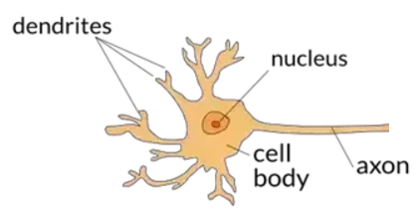
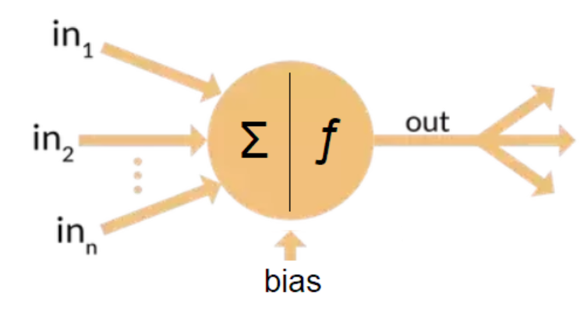
Introduction to ANN
ANN is inspired by human’s brain cell in Biology.

Slide 7
ANN Elements
Input Layer, consists of neurons which represented features or variables for problem solving.
Output Layer, consists of neurons which represented results of calculation in cell body.
Weights, is strength of connection between neurons.
Learning Function, or optimization function is to be used to obtain minimum error by updating weights.
Activation Function, is a function to obtain output according to the problem which would be solved.
Hidden Layer, is optional depending on ANN architecture.

Slide 8
ANN Characteristics
ANN can solve problems which have patterns.
ANN has a good mapping ability. ANN can map the pattern on the input to output which is connected continuously without interruption.
ANN is a method that focuses on the learning process. ANN will be trained using in-sample data to recognize the pattern. Based on the result of this train, ANN will be tested by using out-sample data to identify the pattern. Error of in-sample and out-sample data should be similar.
ANN is tolerant of various types of data. It is able to identify patterns of incomplete, partial, or noisy data.

Slide 9
ANN Implementation
Regression, estimate relationship between independent variable to dependent variable to obtain fitted function according to data.
Classification, predict class of input data according to target or data label.
Clustering, grouping set of data without data label or target.
Forecasting, predict future condition using present and past data or known as time series data.

Slide 10
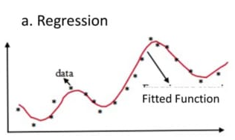
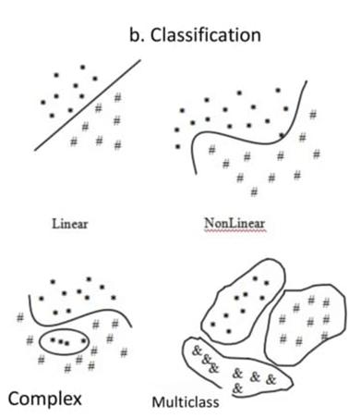
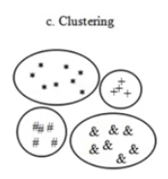
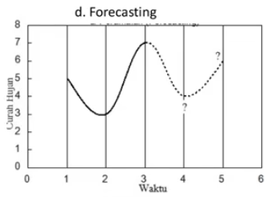
ANN Implementation

Slide 11
Feed-Forward Network Functions

Slide 12
Let’s Start with Perceptron
Output Y is 1 if at least two of the three inputs are equal to 1.

Slide 13
Perceptron
Model is an assembly of inter-connected nodes and weighted links.
Output node sums up each of its input value according to the weights of its links.
Compare output node against some threshold t.
Perceptron Model
or

Slide 14
Perceptron

Slide 15




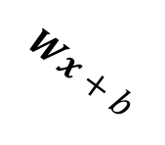







General Structure of Perceptron
Learning Function
Activation Function
Yes
No
Linear Function
Step Function
Bias, to move the output value to get closer to the expected target value
direction: feed-forward

Slide 16
ANN Architecture

Slide 17
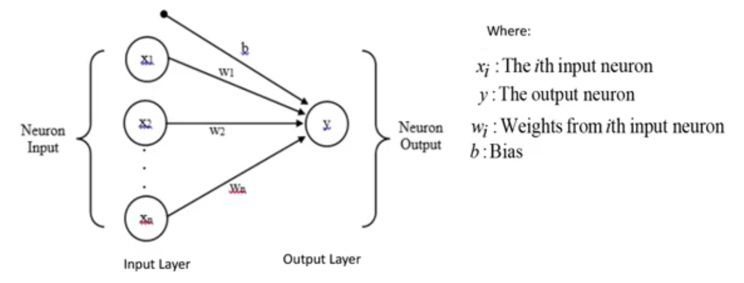
1. Single-Layer Feedforward Network
No hidden layer.
Number of output values is usually 1.
It is good to solve linearly-separable problems.

Slide 18
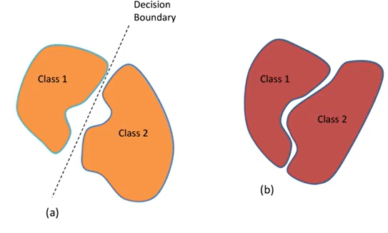
Decision Boundary
(a). Linearly separable vs (b). Non-linearly separable

Slide 19
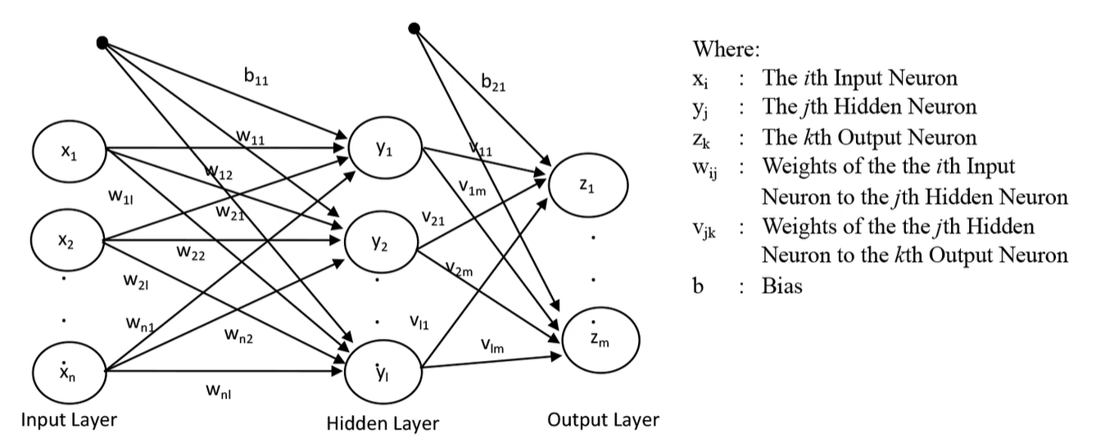
2. Multilayer Feedforward Network
It has at least 1 hidden layer.
Hidden layer also consists of several neurons, but the number of neurons in this layer doesn’t have to be equal the number of neurons in the input layer.
This can be used to solve multi-class problem.

Slide 20
How a Multi-Layer ANN Works
The inputs to the network correspond to the attributes measured for each training tuple.
Inputs are fed simultaneously into the units making up the input layer.
They are then weighted and fed simultaneously to a hidden layer.
The number of hidden layers is arbitrary, although usually only one.
The weighted outputs of the last hidden layer are input to units making up the output layer, which emits the network's prediction.
The network is feed-forward: None of the weights cycles back to an input unit or to an output unit of a previous layer.
From a statistical point of view, networks perform nonlinear regression: Given enough hidden units and enough training samples, they can closely approximate any function.

Slide 21
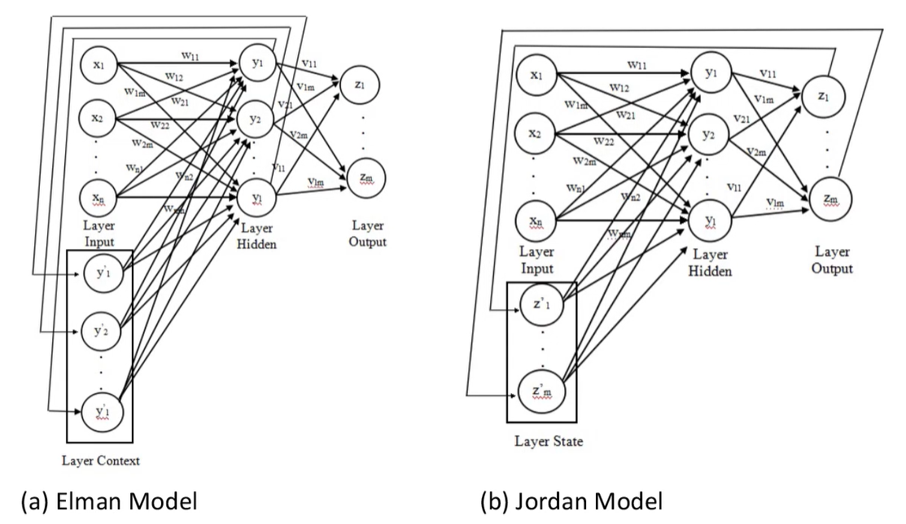
3. Recurrent Neural Network (RNN)
feedback loop
RNN Characteristic:
There is at least one feedback loop.

Slide 22
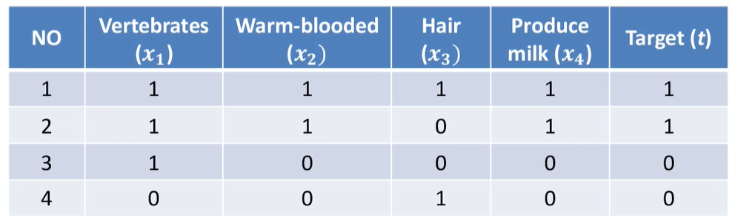
Example 1: ANN Implementation
Assume we want to classify two kinds of animals, namely mammal and non-mammal. To identify this kind of animal, we use features:
Are vertebrates? (yes/no)
Are warm-blooded? (yes/no)
Have hair on their bodies? (yes/no)
Produce milk? (yes/no)
Assume we have the data as follows:
convert data to numeric

Slide 23
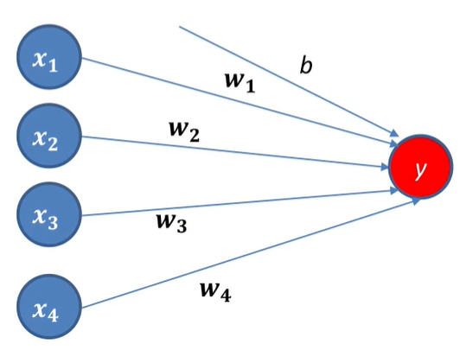
Example 1: ANN Implementation (cont.)
This data consists of features value and target that we obtain from observation.
If features have value = 1, it means yes, and 0 otherwise.
Target =1, it means mammal and 0 otherwise.
From this data, we represent each feature as a neuron in input layer and a neuron output layer, since this is linearly-separable case. Representation of this case in ANN as follows:

Slide 24
Network Training

Slide 25
Artificial Neural Network
Training ANN means learning the weights of the neurons

Slide 26
Defining a Network Topology
Decide the network topology: Specify # of units in the input layer, # of hidden layers (if > 1), # of units in each hidden layer, and # of units in the output layer.
Normalize the input values for each attribute measured in the training tuples to [0.0—1.0].
One input unit per domain value, each initialized to 0.
Output, if for classification and more than two classes, one output unit per class is used.
Once a network has been trained and its accuracy is unacceptable, repeat the training process with a different network topology or a different set of initial weights.

Slide 27
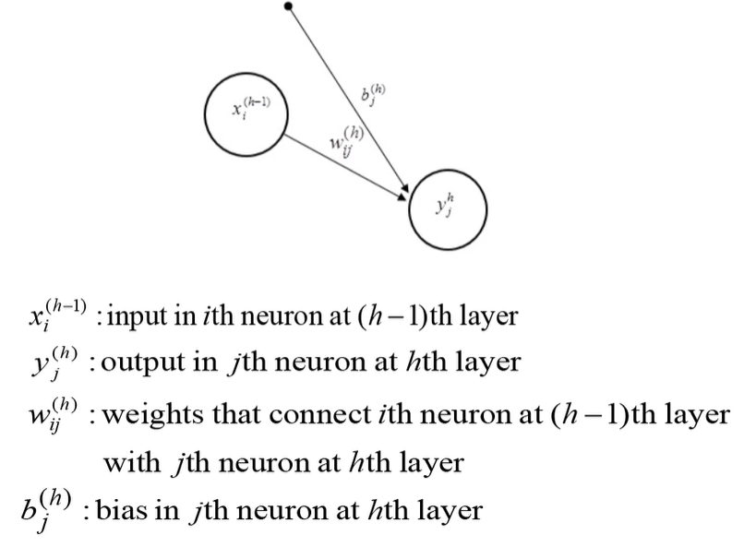
Learning Function and Activation Function
If ANN is presented as follows:
Where:

Slide 28
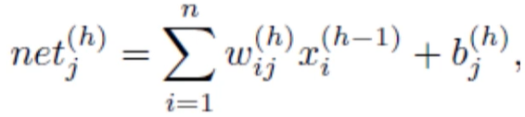

Learning Function and Activation Function (cont.)
Such that:
For j=1,2,…,l where l is the total number of neurons in layer h. Result of this linear combination will be the input of activation function. For simplicity if:
Then activation function (u) will be: (next slides)

Slide 29
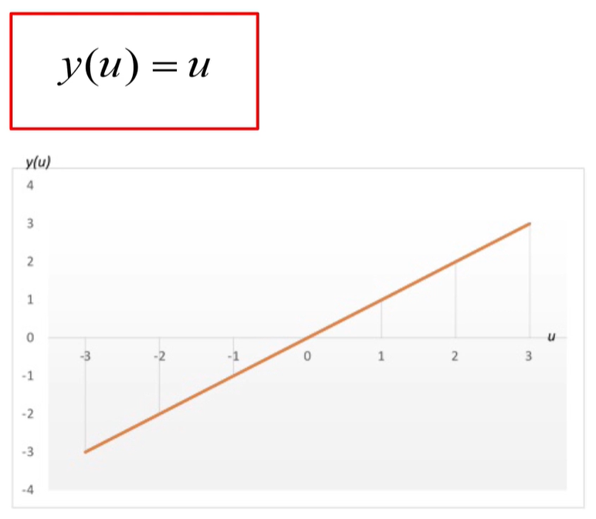
Activation Function
Linear Function

Slide 30
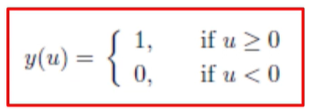
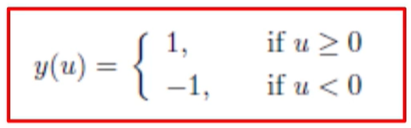
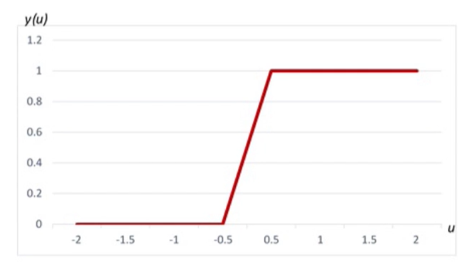
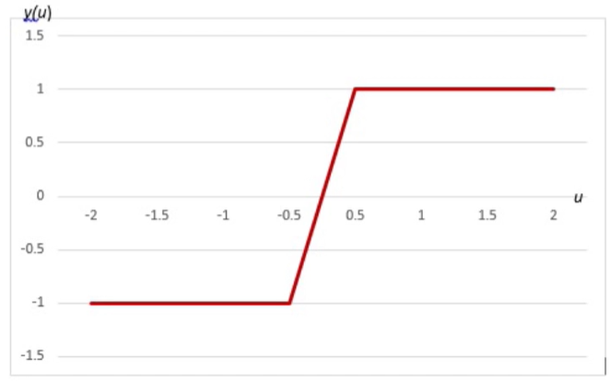
Activation Function (cont.)
Step Function
Binary/Hard Limit Function
Bipolar Function

Slide 31
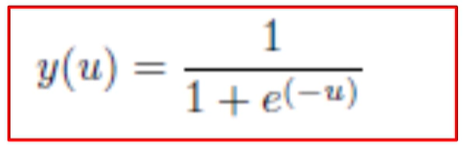
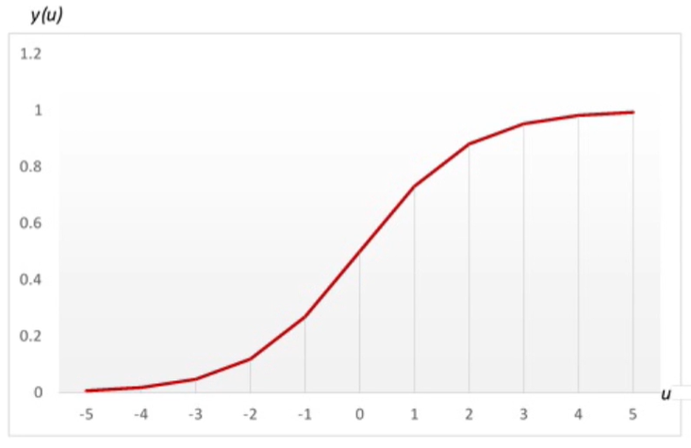
Activation Function (cont.)
Logistic Sigmoid Function

Slide 32
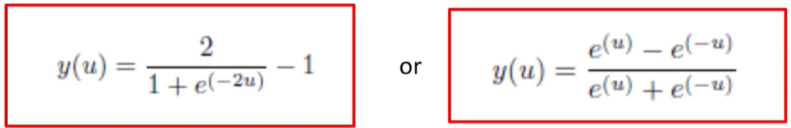
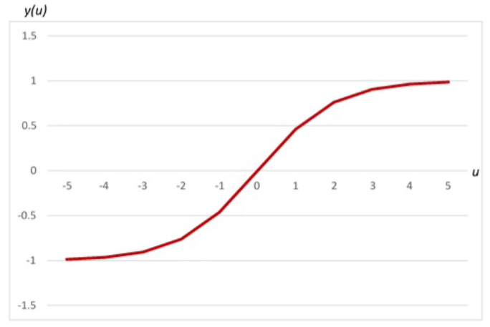
Activation Function (cont.)
Hyperbolic Tangent Sigmoid Function (tanh)

Slide 33
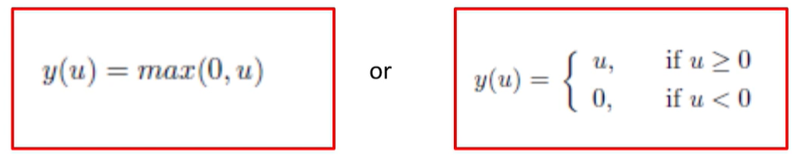
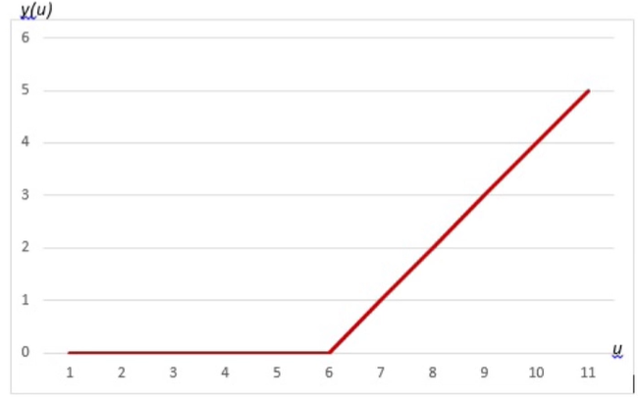
Activation Function (cont.)
Rectified Linear Unit (ReLU) Function

Slide 34
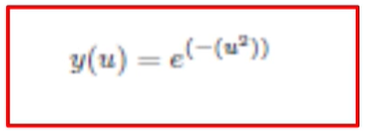
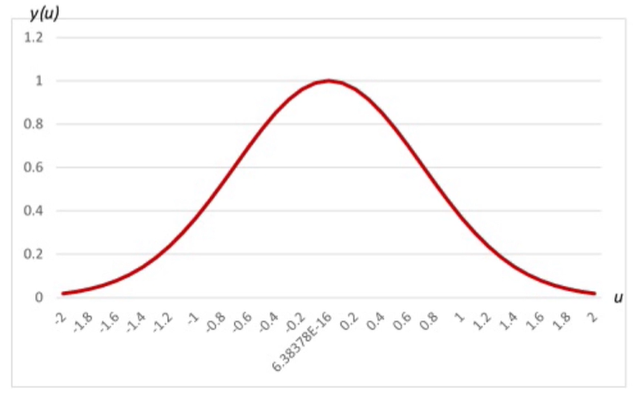
Activation Function (cont.)
Gaussian Function
Notes:
Keenam Activation Functions ini untuk NN yang shallow. Untuk deep learning, kita menggunakan activation function yang lain.

Slide 35
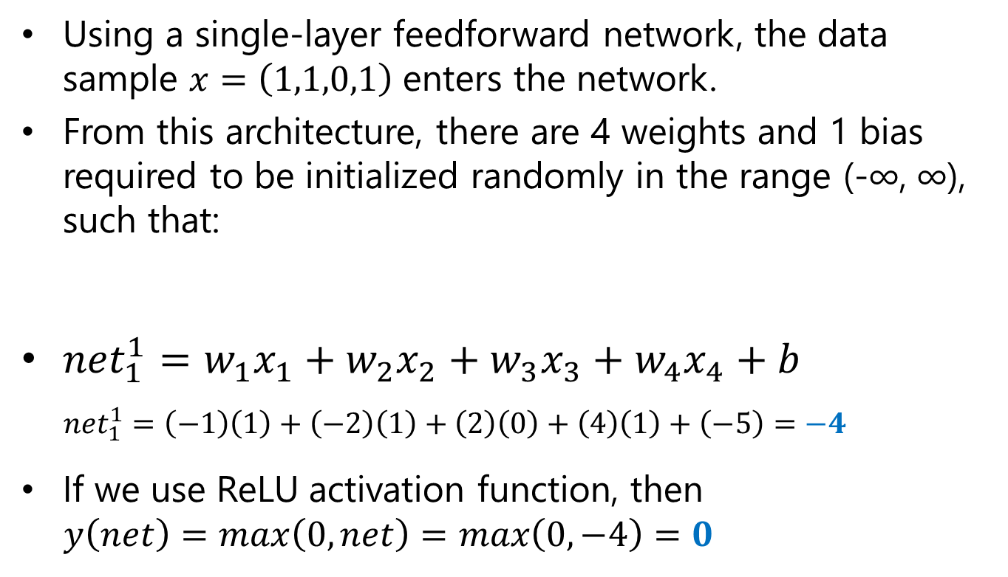
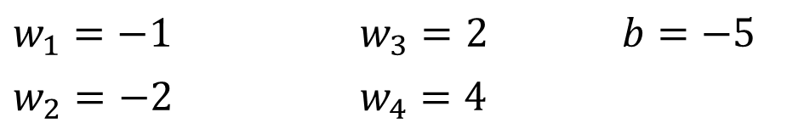
Example 2: Activation Function Calculation
What if we use other activation functions?

Slide 36
Perceptron Algorithm

Slide 37
Perceptron Algorithm
Iteratively process a set of training tuples & compare the network's prediction with the actual known target value.
For each training tuple, the weights are modified to minimize the mean squared error between the network's prediction and the actual target value.
Steps:
Initialize weights to small random numbers, associated with biases.
Loop:
Propagate the inputs forward (by applying activation function).
Updating weights and biases.
Terminating condition (when error is very small, etc.).

Slide 38
Perceptron Algorithm (cont.)
Initialize the weights (w₀, w₁, …, w_{k})
Adjust the weights in such a way that the output of ANN is consistent with class labels of training examples.
Objective function:
Find the weights w_{i}’s that minimize the above objective function. How to find them?

Slide 39
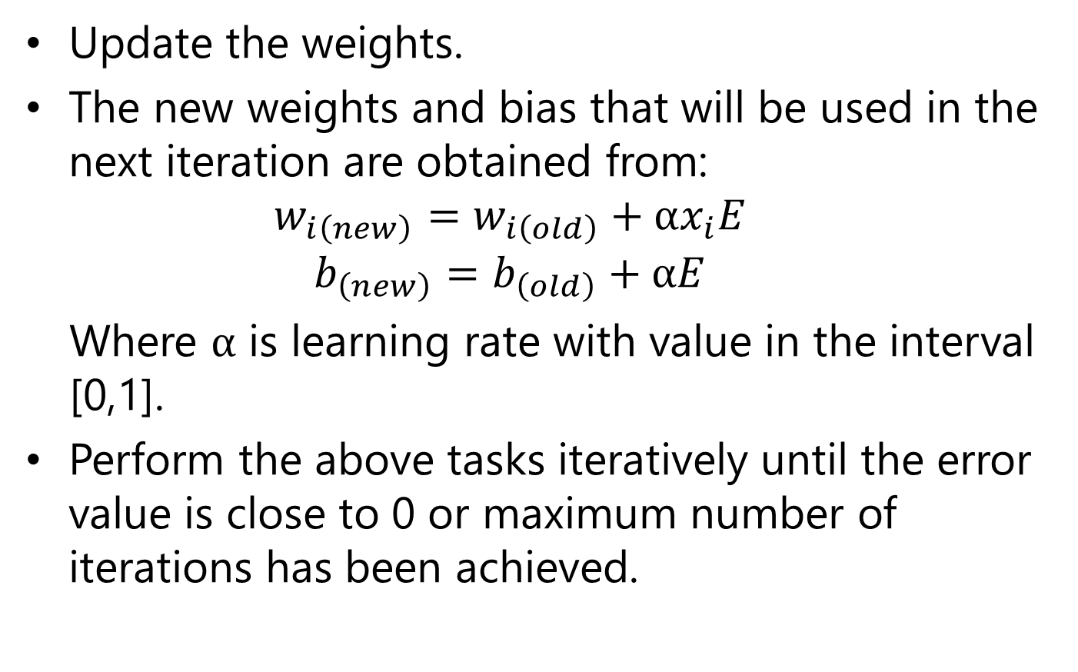
Perceptron Algorithm: Updating Weights

Slide 40
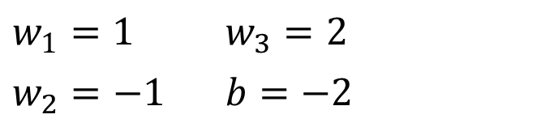
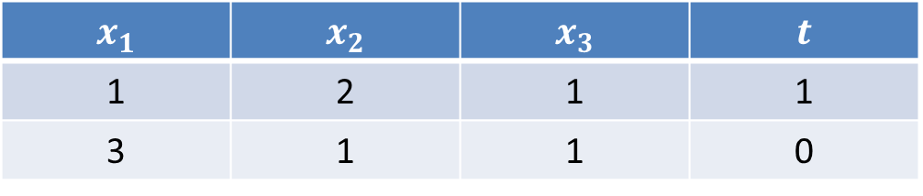
Exercise: Perceptron Algorithm
Defined training set of data input and target:
Based on this data, please simulate perceptron algorithm for one iteration.
Let’s say we use binary activation function, and the followings are the initial values of:
1 | 2 | 1 | 1
3 | 1 | 1 | 0

Slide 41
Backpropagation Neural Network (BPPN)

Slide 42
Types of Learning
Batch learning
All samples are used in each iteration of training.
Mini-Batch Learning
All samples are divided into groups or mini batches.
For each iteration, one mini-batch is used.
The number of iterations should be greater than that of mini-batches.
Online Learning
Each iteration of training only uses one sample.
The number of iterations should be greater than that of samples.

Slide 43
Learning Algorithm: Backpropagation
Iteratively process a set of training tuples & compare the network's prediction with the actual known target value.
For each training tuple, the weights are modified to minimize the mean squared error between the network's prediction and the actual target value.
Modifications are made in the “backwards” direction: from the output layer, through each hidden layer down to the first hidden layer, hence “backpropagation”.
Steps:
Initialize weights to small random numbers, associated with biases.
Propagate the inputs forward (by applying activation function).
Backpropagate the error (by updating weights and biases).
Terminating condition (when error is very small, etc.).

Slide 44
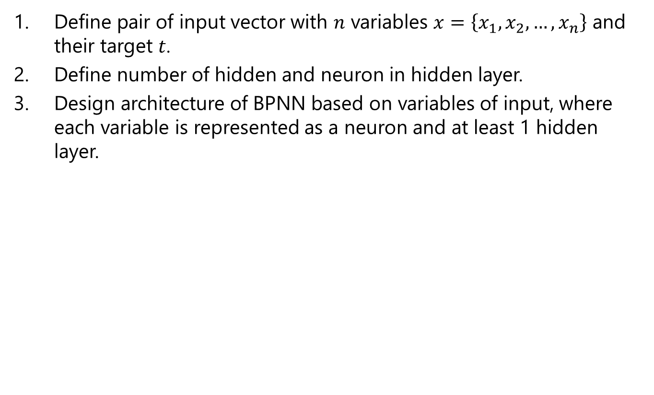
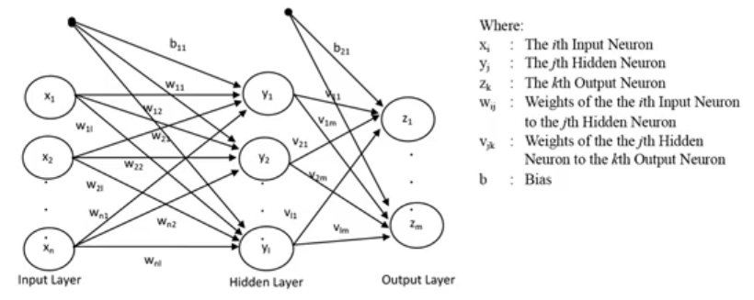
Backpropagation Neural Network Algorithm

Slide 45
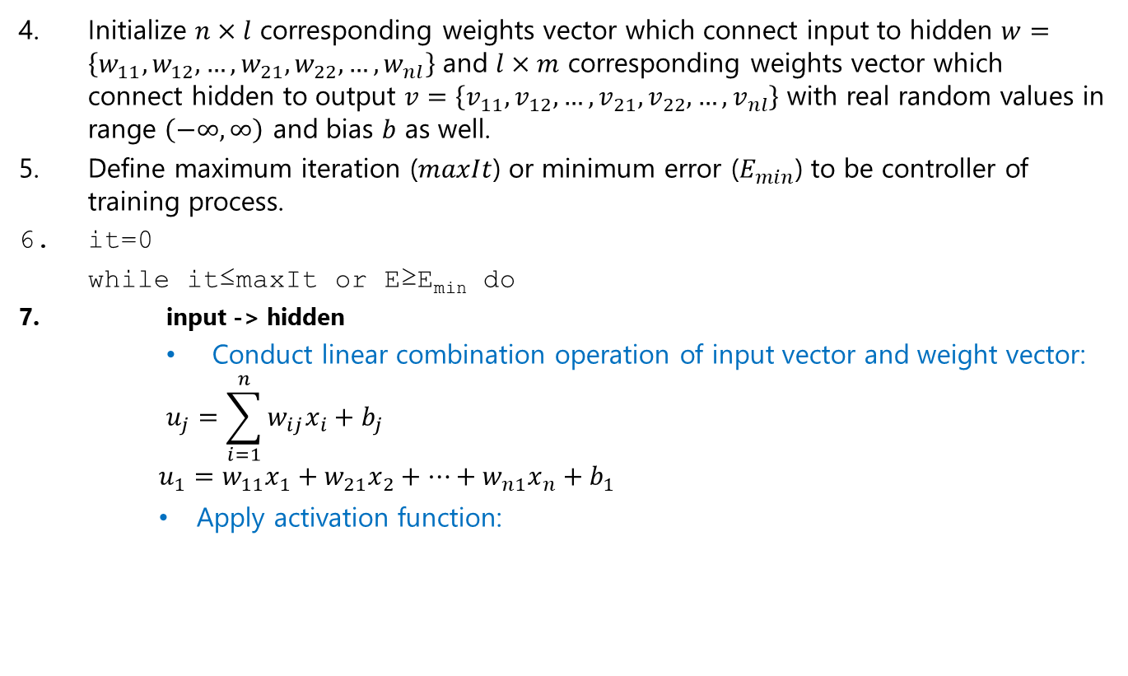
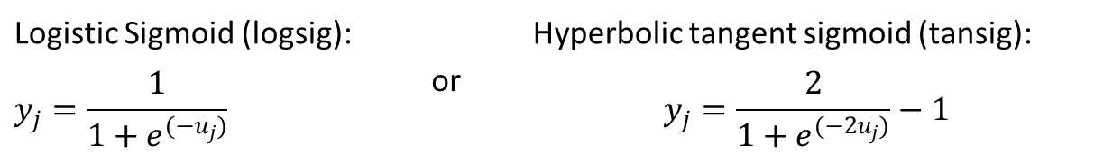
Backpropagation Neural Network Algorithm (cont.)
Logistic Sigmoid (logsig): | or | Hyperbolic tangent sigmoid (tansig):

Slide 46
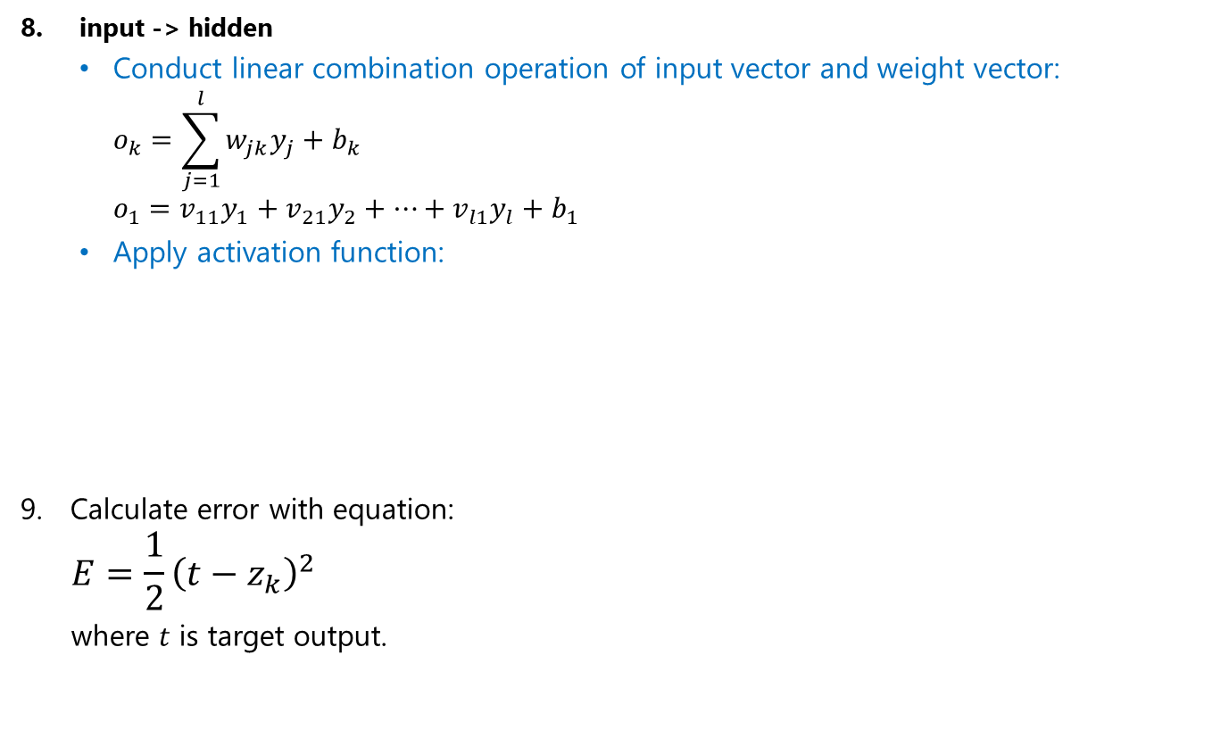
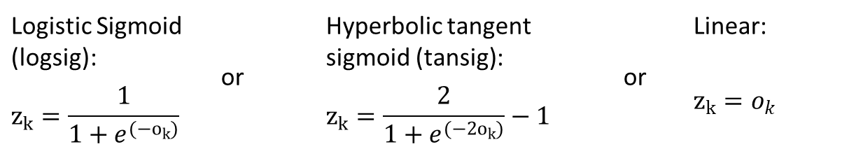
Backpropagation Neural Network Algorithm (cont.)
Logistic Sigmoid (logsig): | or | Hyperbolic tangent sigmoid (tansig): | or | Linear:

Slide 47
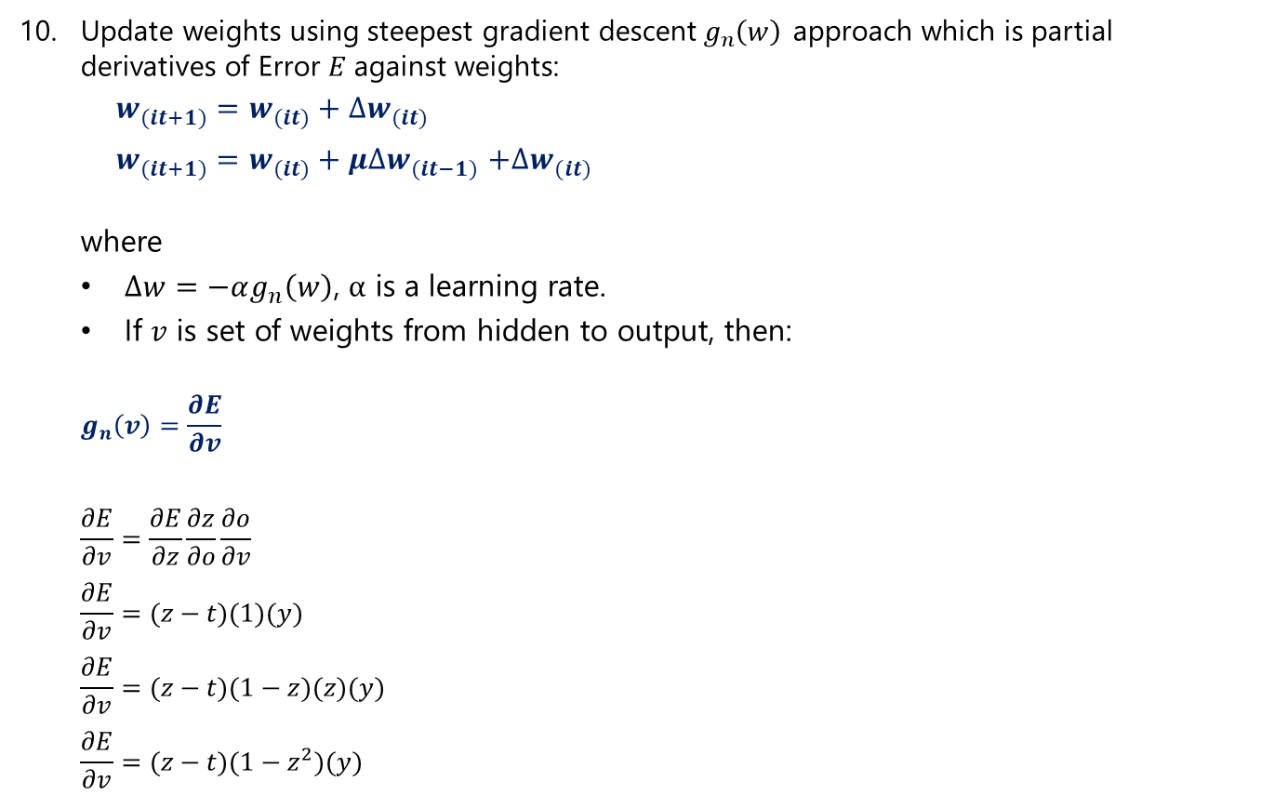
Backpropagation Neural Network Algorithm (cont.)
(without momentum)
(using momentum μ)
(chain rule)
, if activation function from hidden to output is linear.
, if activation function from hidden to output is logsig.
, if activation function from hidden to output is tansig.

Slide 48
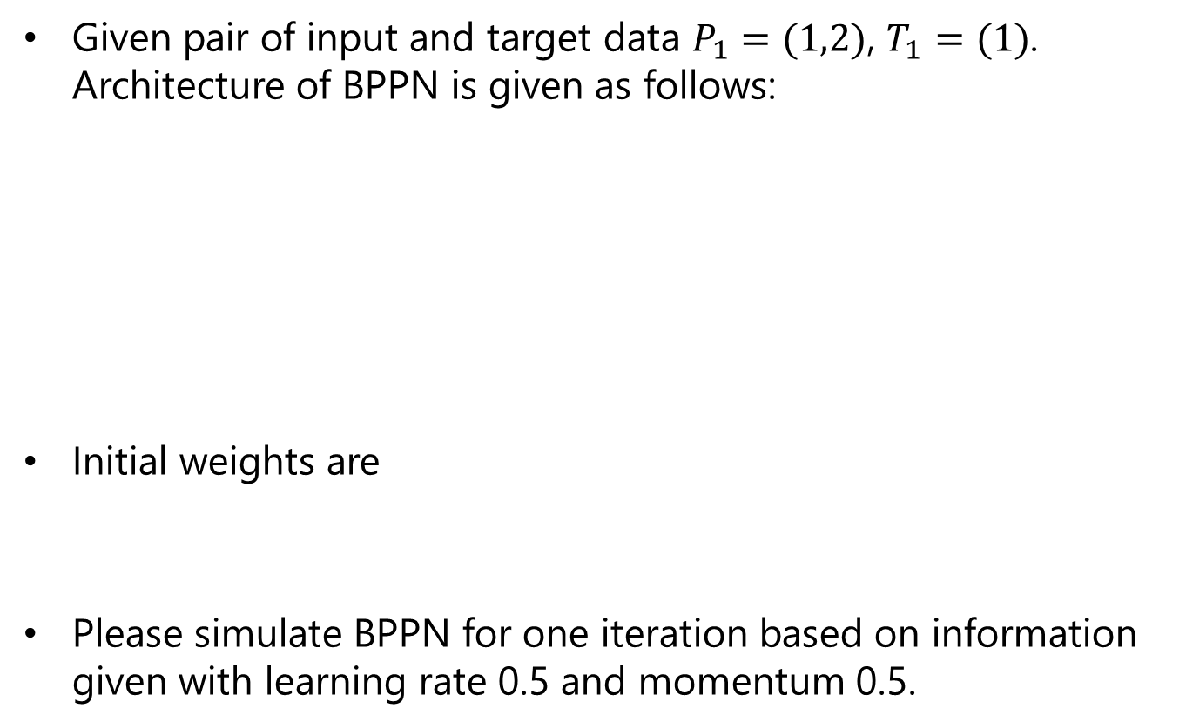
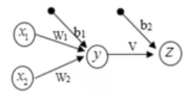
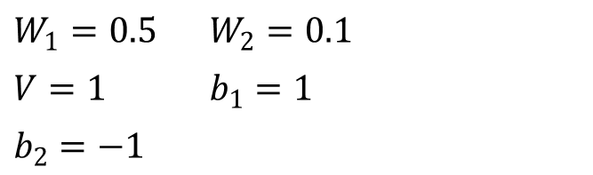
Exercise

Slide 49
Efficiency and Interpretability
Efficiency of backpropagation: Each epoch (one iteration through the training set) takes O(|D| * w), with |D| tuples and w weights, but # of epochs can be exponential to n, the number of inputs, in worst case
For easier comprehension: Rule extraction by network pruning
Simplify the network structure by removing weighted links that have the least effect on the trained network
Then perform link, unit, or activation value clustering
The set of input and activation values are studied to derive rules describing the relationship between the input and hidden unit layers
Sensitivity analysis: assess the impact that a given input variable has on a network output. The knowledge gained from this analysis can be represented in rules

Slide 50
Neural Network as a Classifier
Weakness
Long training time
Require a number of parameters typically best determined empirically, e.g., the network topology or “structure.”
Poor interpretability: Difficult to interpret the symbolic meaning behind the learned weights and of “hidden units” in the network
Strength
High tolerance to noisy data
Ability to classify untrained patterns
Well-suited for continuous-valued inputs and outputs
Successful on an array of real-world data, e.g., hand-written letters
Algorithms are inherently parallel
Techniques have recently been developed for the extraction of rules from trained neural networks
Notes:
Demo in RapidMiner

Slide 51
References
Online Course by Lili Ayu Wulandhari, S.Si., M.Sc., Ph.D. https://www.youtube.com/watch?v=eHmFexrOTUg&list=PLhdyHWHl4RG_7KBV5sx3q_bS39bJX685o
Bishop, C. M. (2006). Pattern recognition and machine learning. springer.
Mitchell, Tom M. (1997). Machine learning. McGraw Hill.
Harrington, P. (2012). Machine learning in action. Manning Publications Co..

Slide 52
Q&A

Slide 53
Thank You

